Slide 1

CAPSTONE 1 · 80% IT DEVELOPMENT DEFENSE
DEVELOPING A GRADUATE STUDENT
LIFECYCLE MONITORING AND ANALYTICS
PLATFORM FOR THE UNIVERSITY OF
ST. LA SALLE GRADUATE SCHOOL
CAP-2521-IT
Presented by :
Mendoza, Oseña, Sanson, Tumbaga

Slide 2

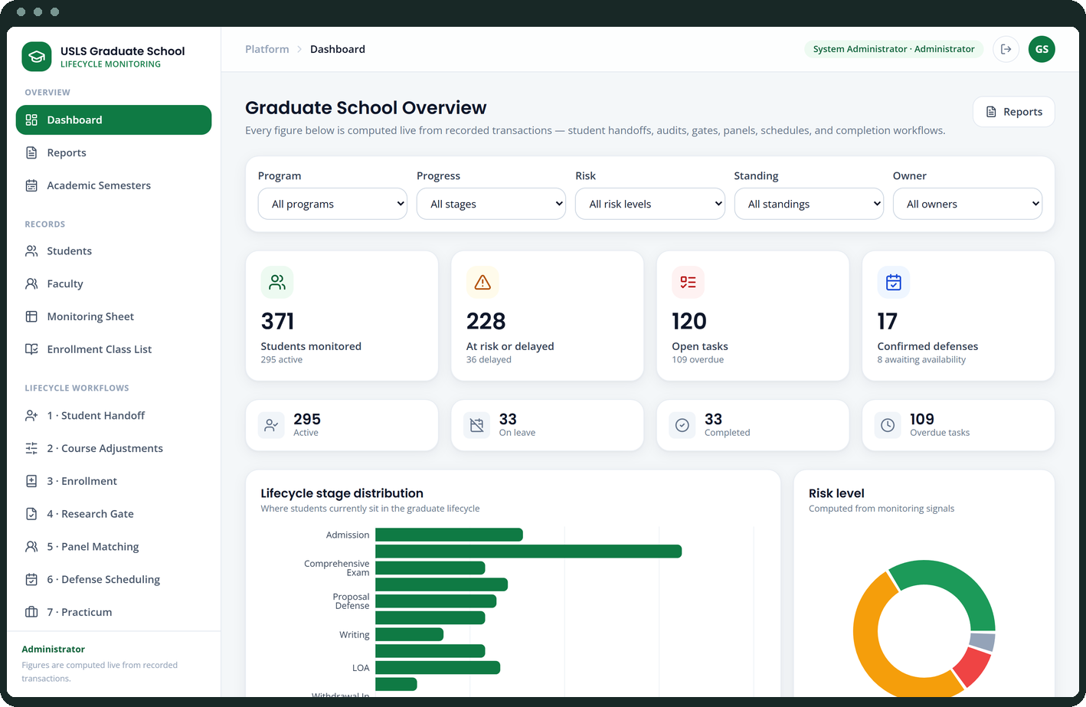
THE ORGANISATION
The University of St. La Salle Graduate School, Bacolod City
Organizational Profile — Section 1.2 of the approved proposal
▪ Programs across five academic areas — Arts and Sciences, Business, Education, Engineering and Technology, and Nursing. These differ in curriculum structure, documentation requirements, practicum needs and research milestones.
▪ One lifecycle, many handoffs — admission handoff, enrollment monitoring, curriculum alignment, coursework tracking, leave of absence and readmission, practicum for applicable programs, research milestones, withdrawal, and graduation endorsement.
▪ Seven stakeholder roles — graduate students, research advisers, the Academic Coordinator, the Research Coordinator, Graduate School Office Staff, the Dean, and faculty. Each has different responsibilities and information needs.
▪ A monitoring and support system — it does not replace the official admissions, Registrar or Accounting processes, and it does not hold the official academic record.
Each stage is carried out through handoffs among students, faculty, coordinators,
staff and decision-making offices. Monitoring has to follow those handoffs.

Slide 3
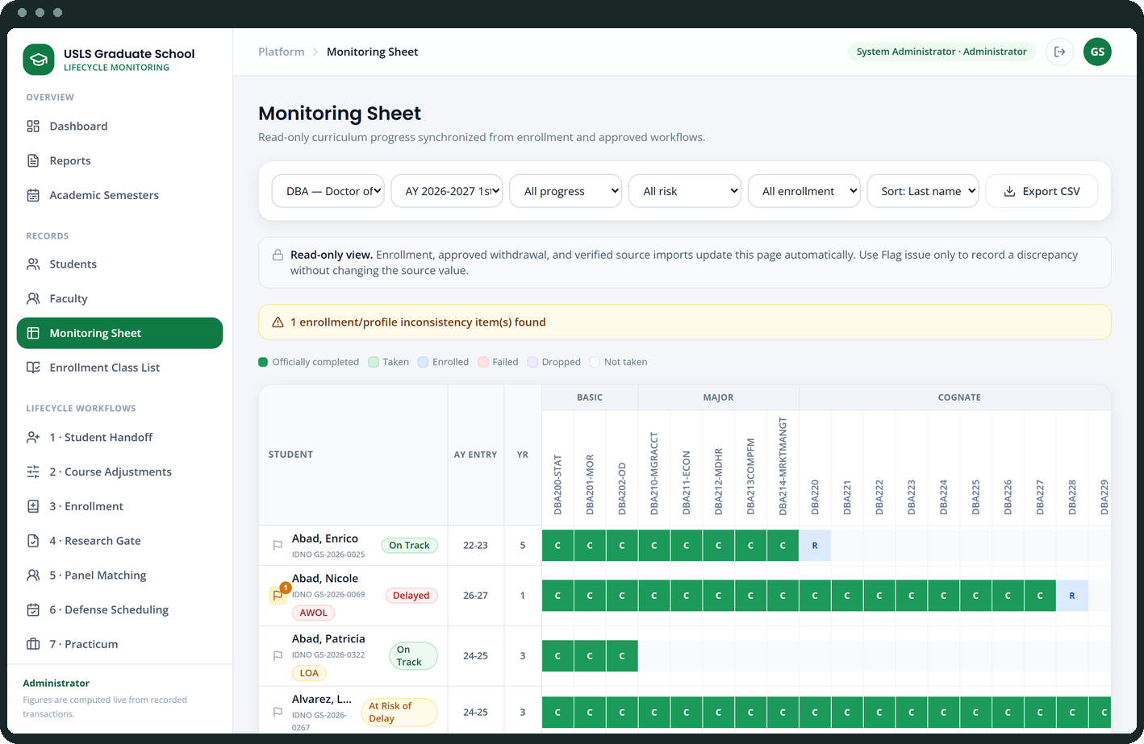
THE PROBLEM
Status is recorded across multiple sources, with no consolidated view
Main Problem Statement — Section 1.4 of the approved proposal
▪ As approved — “Graduate student status is recorded across multiple sources, and the Graduate School does not have one consolidated view. Because monitoring and processing rely on manual checking and encoding, status confirmation is slow and prone to human error.”
▪ A clear view of progress — tracking spans admission, enrollment, coursework, research milestones, practicum, leave and graduation. No single view shows where a student stands across all of them.
▪ Updates and evidence on time — status arrives from admissions signals, monitoring sheets, protocol forms and email, so updates are delayed, missed, or recorded incorrectly.
▪ Records combined into one status view — the information exists, but staff piece it together from separate tools before they can confirm a student’s standing.
Section 1.4 lists six difficulties that follow from this. The next slide continues them.

Slide 4
WHAT THIS MEANS
The difficulties that follow from it
Continuing the list in Section 1.4 of the approved proposal
▪ Difficulty answering basic monitoring questions quickly — where the student is now, what is pending or overdue, who owns the next action, and which cases may be delayed, all without manual checking and reconciliation.
▪ Difficulty acting early when confirmation is slow — when status confirmation takes too long, follow-ups and decisions are delayed with it, leading to repeated follow-ups and slower response to stalled cases.
▪ Difficulty generating timely and reliable reports — subject needs for class planning, graduating lists, LOA monitoring and residency tracking are pulled from separate records and combined by hand. Residency is still computed manually by counting the student’s start and end years.
▪ This is not solved by adding more people — even with more staff assigned, the process stays manual, slower, more costly, and still prone to encoding errors, missed updates and inconsistent results.
The demonstration that follows answers these from recorded data rather than by hand.

Slide 5
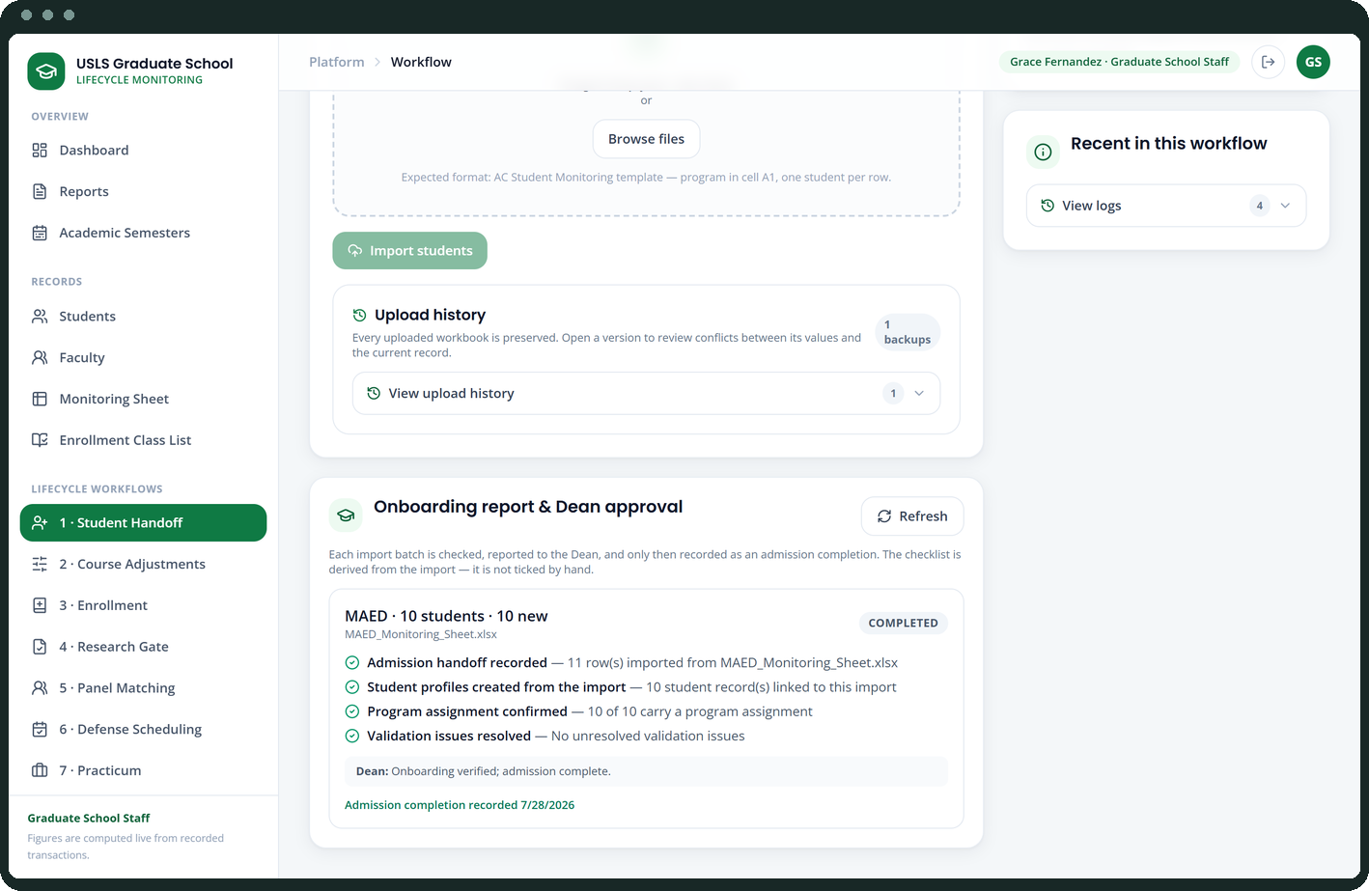
HOW THE NUMBERS ARE COMPUTED
Where subject demand comes from
Asked for at the consultation: if the screen says eight students, how did it reach eight?
▪ Start from the curriculum — each student is tagged to a published curriculum version, which fixes the full list of subjects their program requires of them.
▪ Subtract what is already settled — subjects with a recorded completion, and subjects they are actively enrolled in, are removed.
▪ What remains is a need — the count for a subject is the number of students that subject is still outstanding for. Nothing is stored; it is recalculated whenever the screen is opened.
▪ Students needing and Not taken differ — Students needing is the subset due to take it next term under their curriculum sequence. Not taken is every student who has not finished it, whenever they are due. Only the first drives the decision.
The report names the students behind every count, so the number can be checked rather than trusted.

Slide 6
BEST FEATURES · 1 OF 4
Step-by-step process observation
Twelve modelled processes, each running as an observable board
▪ Every process runs as a board by stage — submitted, under review, returned, approved, tagged — so the current owner is visible at a glance.
▪ The work queue names the role — every open case shows which role owns the next action and how long it has been outstanding.
▪ The activity log is complete — every decision, handoff and status change is recorded with the actor, the timestamp and the previous value.
▪ Nothing advances silently — a stage changes only through the action that caused it, which is what makes the audit trail worth having.
This is what replaces “I will follow up and get back to you.”

Slide 7
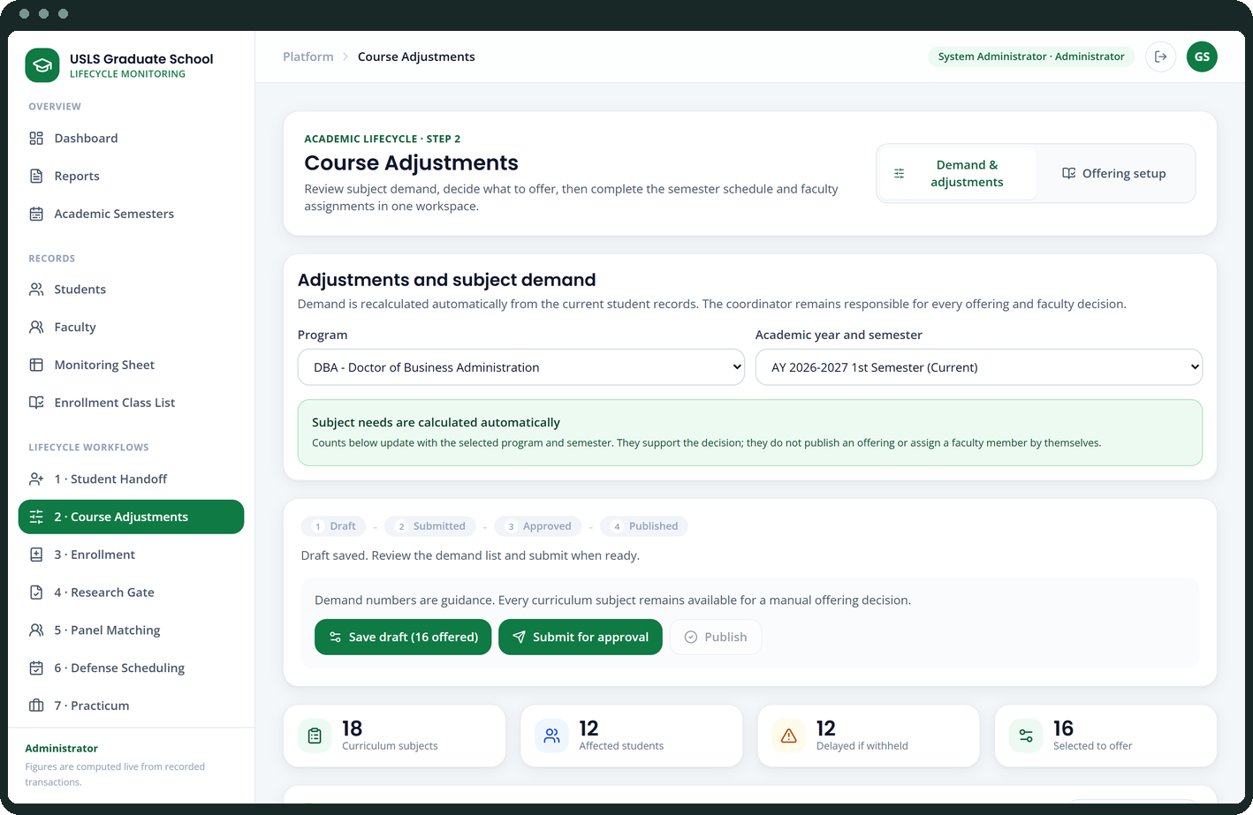
BEST FEATURES · 2 OF 4
Faculty matching for defense panels
A ranked shortlist that shows the reason for every name on it
▪ Scored, not keyword-matched — specialization terms are weighted by how rare they are across all faculty profiles, so a shared common word counts for far less than a genuine specialism.
▪ Grounded in the faculty member’s own CV — retrieval pulls the relevant CV sections and presents them as the evidence behind each suggestion.
▪ The whole basis is on screen — match score, the matching keywords, and the current teaching and panel load, together.
▪ Advisory by design — the shortlist is a recommendation with a stated basis. A person selects the panel.
Explainable: the data used, the reasoning, and the person who decides.

Slide 8
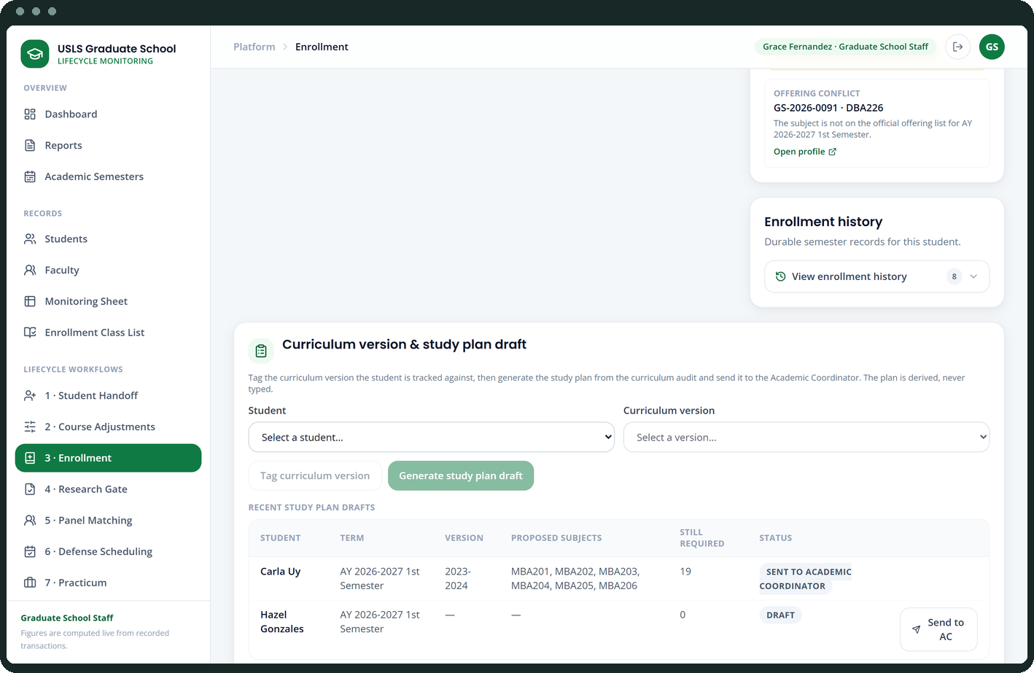
BEST FEATURES · 3 OF 4
Retrieval-augmented policy assistance
Answers grounded in the Graduate School’s own handbook, with the source shown
▪ The handbook is indexed, not summarised — policy and research documents are chunked and embedded, and the index rebuilds itself whenever the source documents change.
▪ Semantic retrieval with a working fallback — vector search over Gemini embeddings, backed by a lexical retriever so the assistant still answers when no API key is configured.
▪ Every answer carries its source — the document and page are returned with the answer, so it can be checked against the handbook rather than trusted.
▪ Scoped and routed — operational questions are answered from the verified reports instead of being generated, and a student cannot obtain staff-only information through it.
Decision support grounded in the source — not an official ruling.

Slide 9
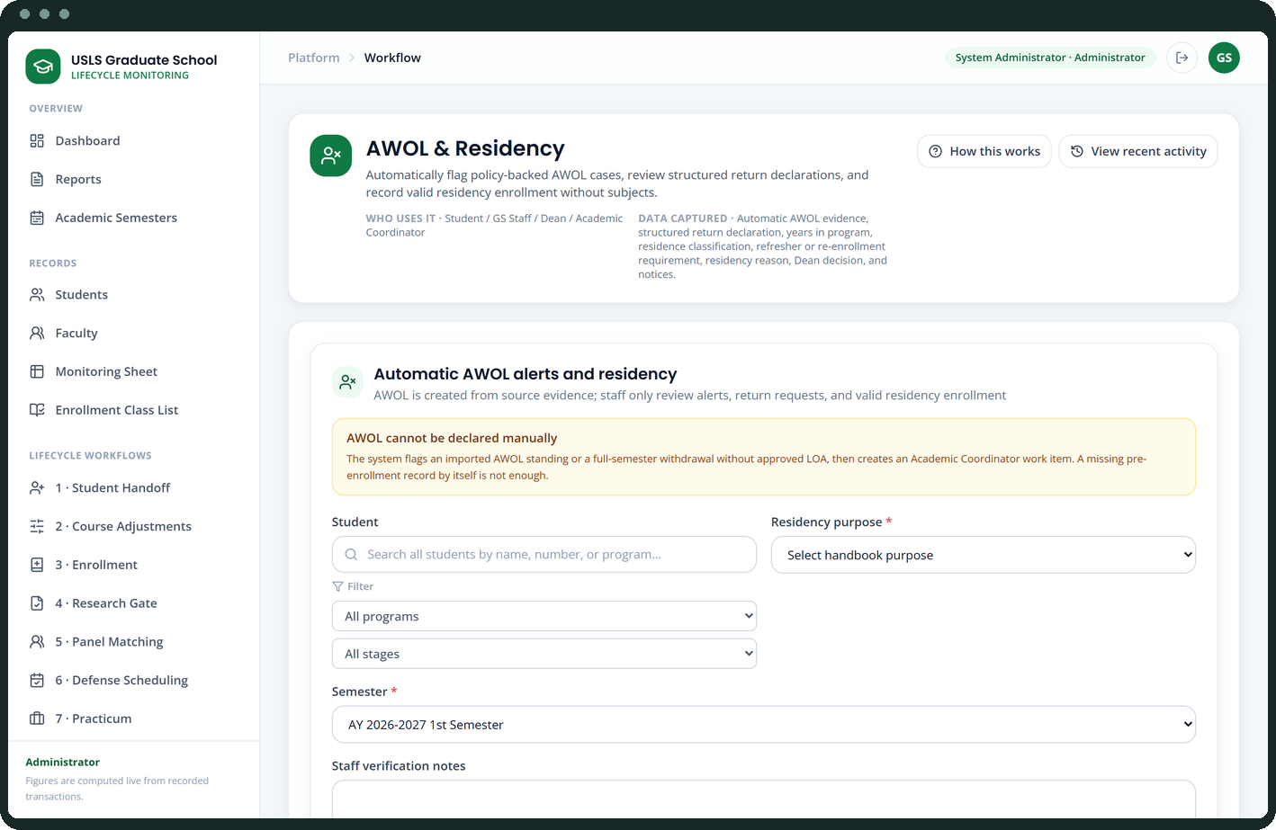
BEST FEATURES · 4 OF 4
Live availability into defense scheduling
Finding the hour when four panellists and a student can actually meet
▪ Connected calendars are queried live — the Google free/busy API is combined with each faculty member’s recorded weekly working hours.
▪ A slot is proposed only where everyone is free — the student and every panel member, across both sources.
▪ It fails closed — where availability cannot be established the system reports that, instead of proposing a slot it cannot support.
▪ Rescheduling is recorded, not overwritten — the previous schedule stays in the history with the reason it moved.
The scheduling problem this platform was asked to solve.

Slide 10
Thank you
Graduate Student Lifecycle Monitoring and Analytics Platform
University of St. La Salle Graduate School
CAP-2521-IT · Mendoza, Oseña, Sanson, Tumbaga
Capstone 1 · 80% IT Development Defense · July 2026

Slide 11
Appendix
Every screen in the system

Slide 12
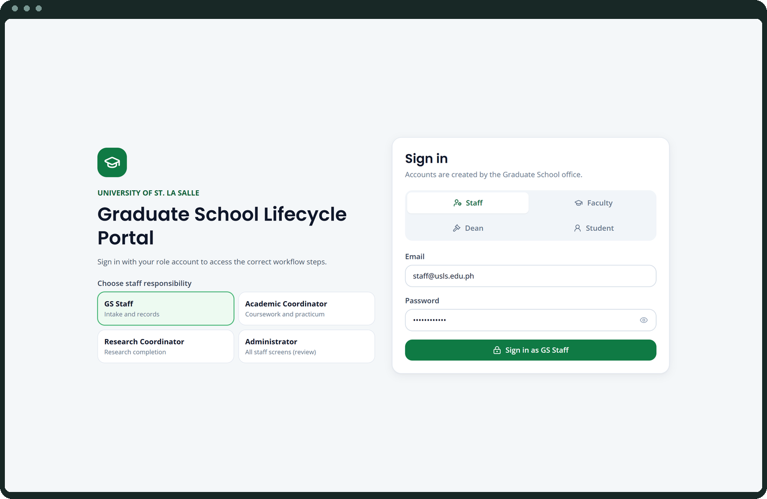
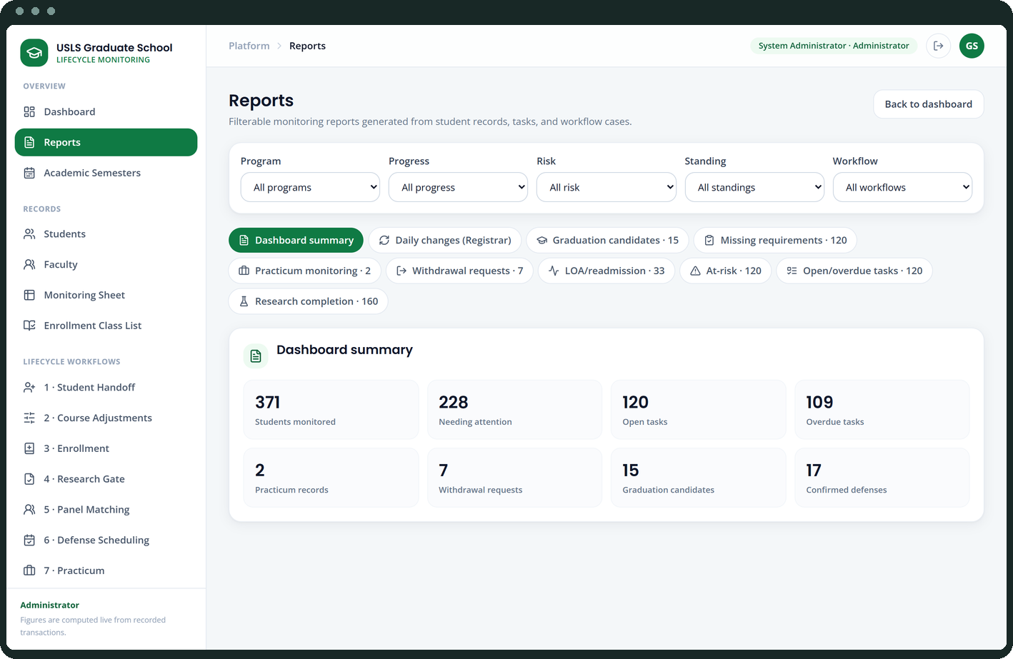
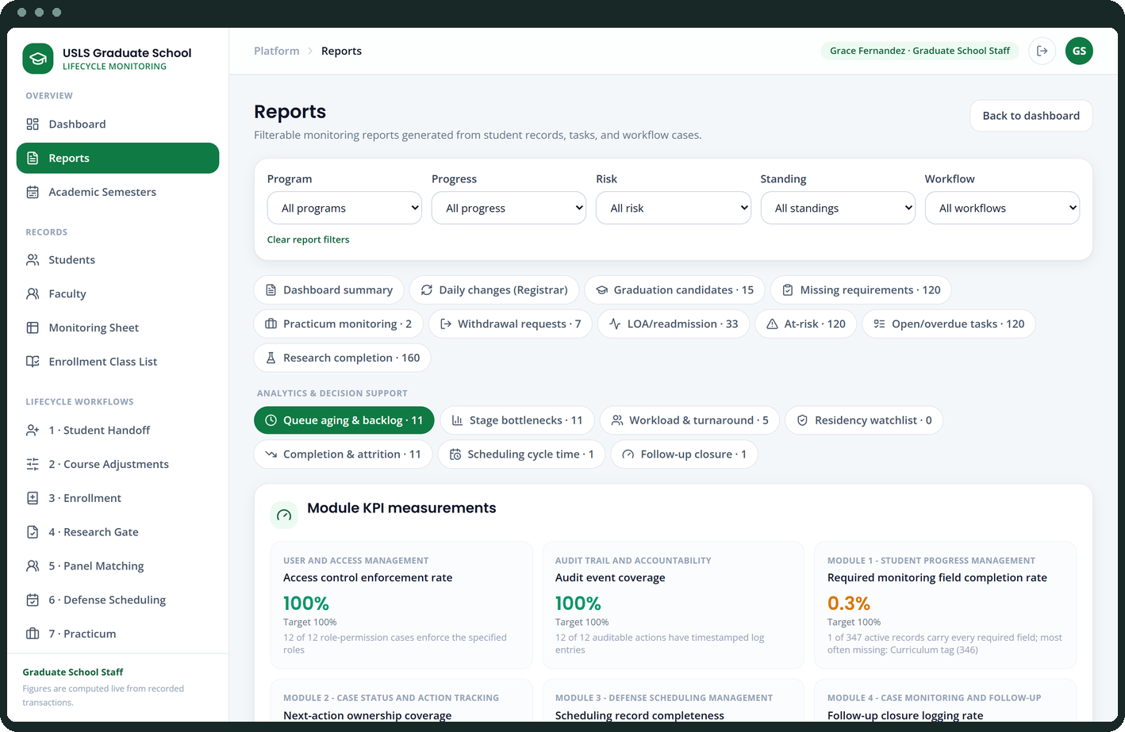
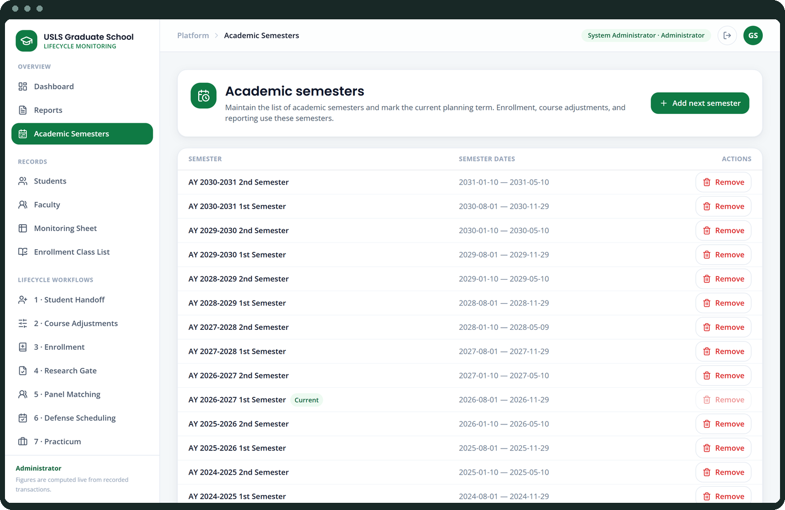
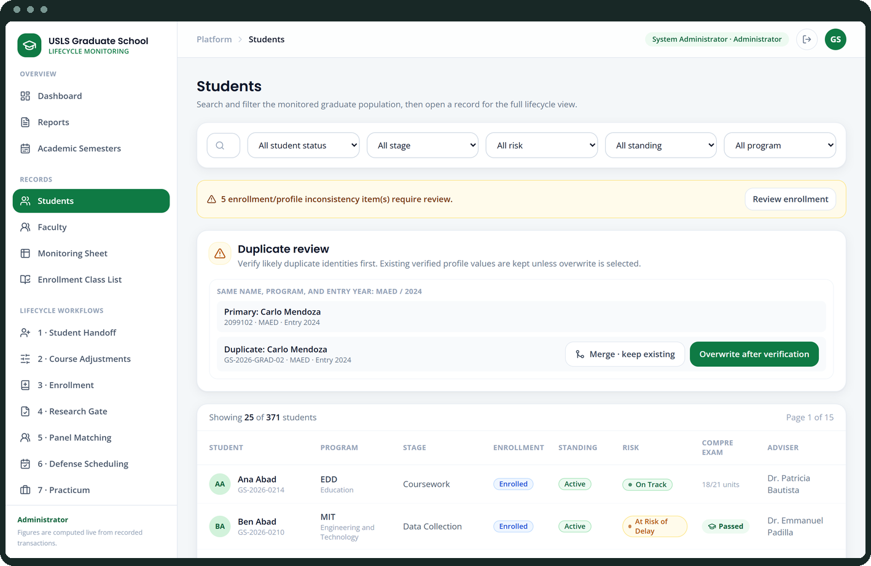
APPENDIX
System screens
1–6 of 36
Login
Dashboard
Reports
Analytics & KPIs
Academic semesters
Students

Slide 13
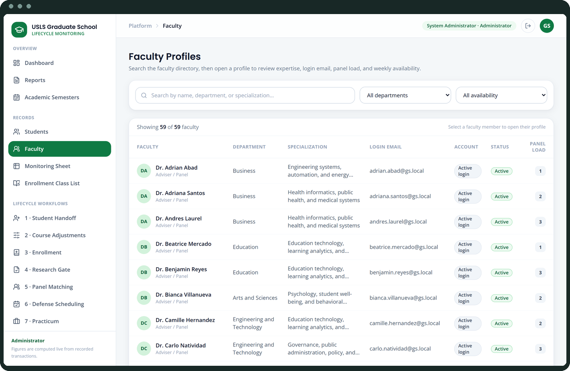
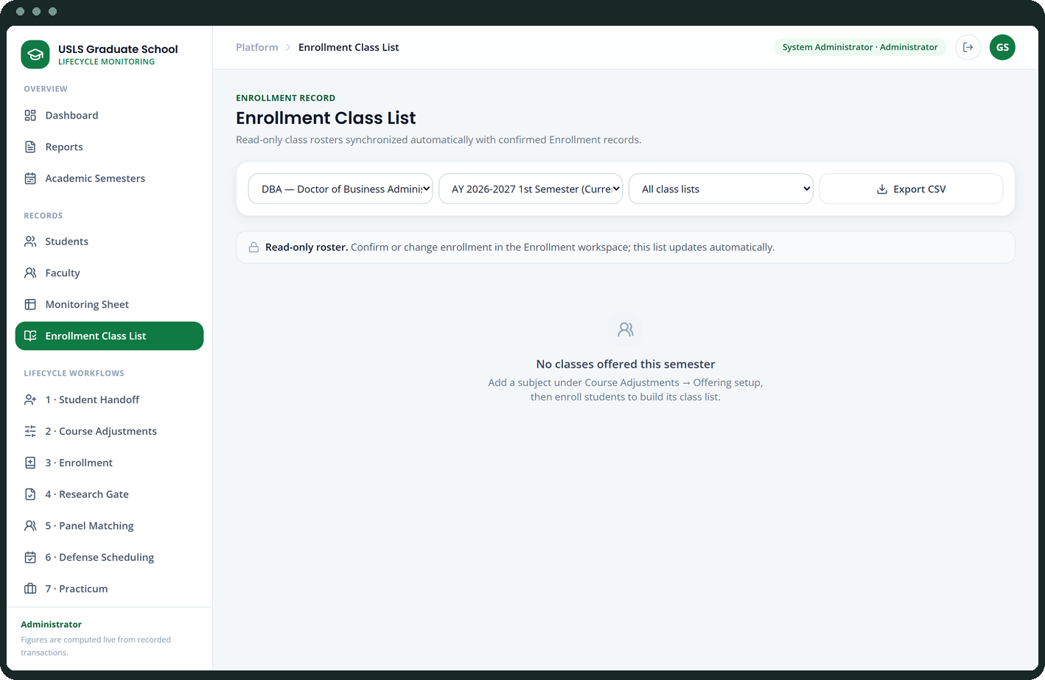
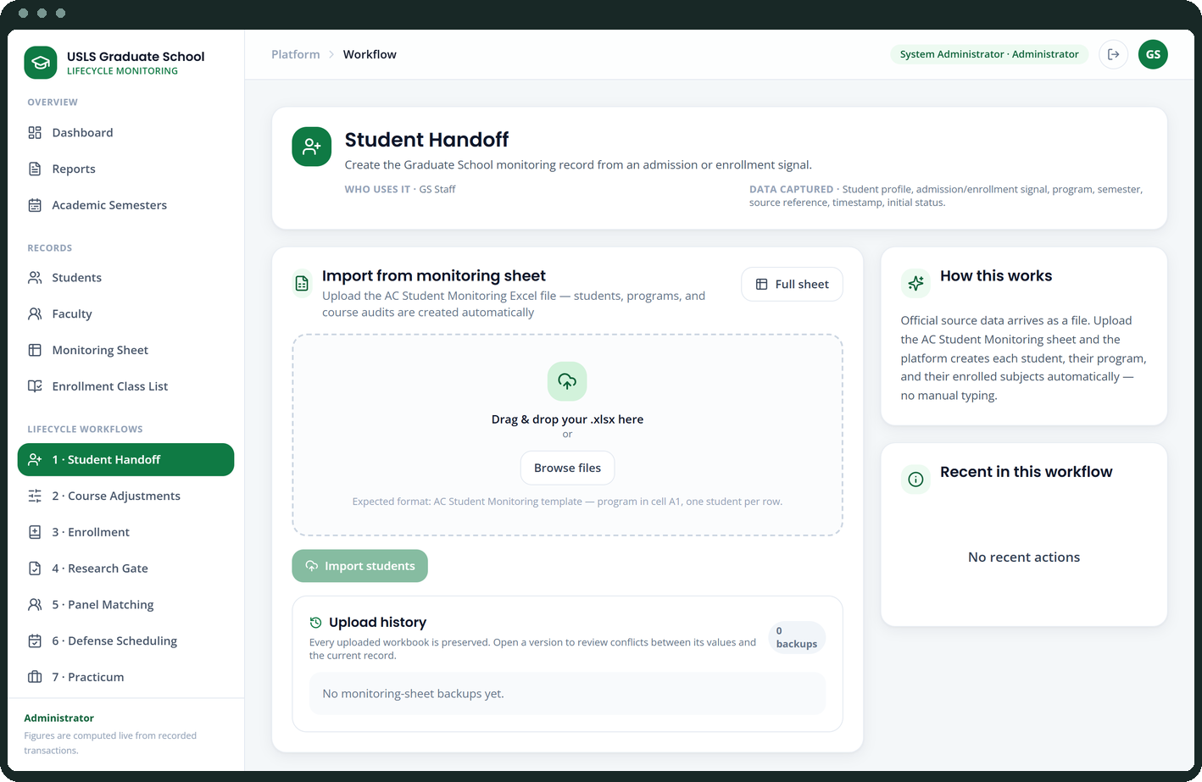
APPENDIX
System screens
7–12 of 36
Faculty
Monitoring sheet
Enrollment class list
Student handoff
Onboarding report & Dean gate
Course adjustments

Slide 14
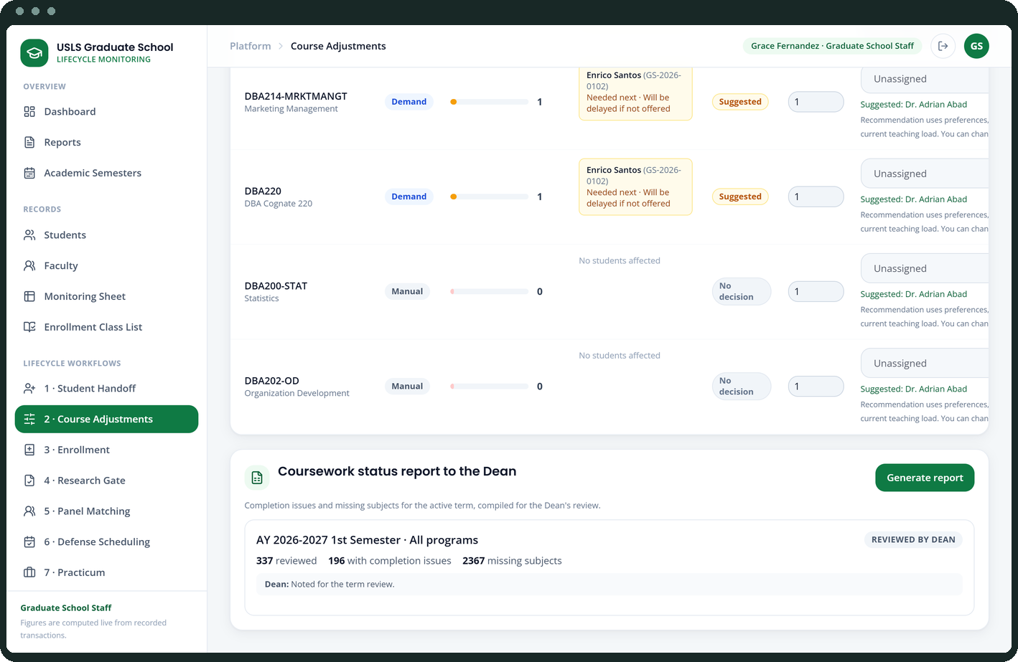
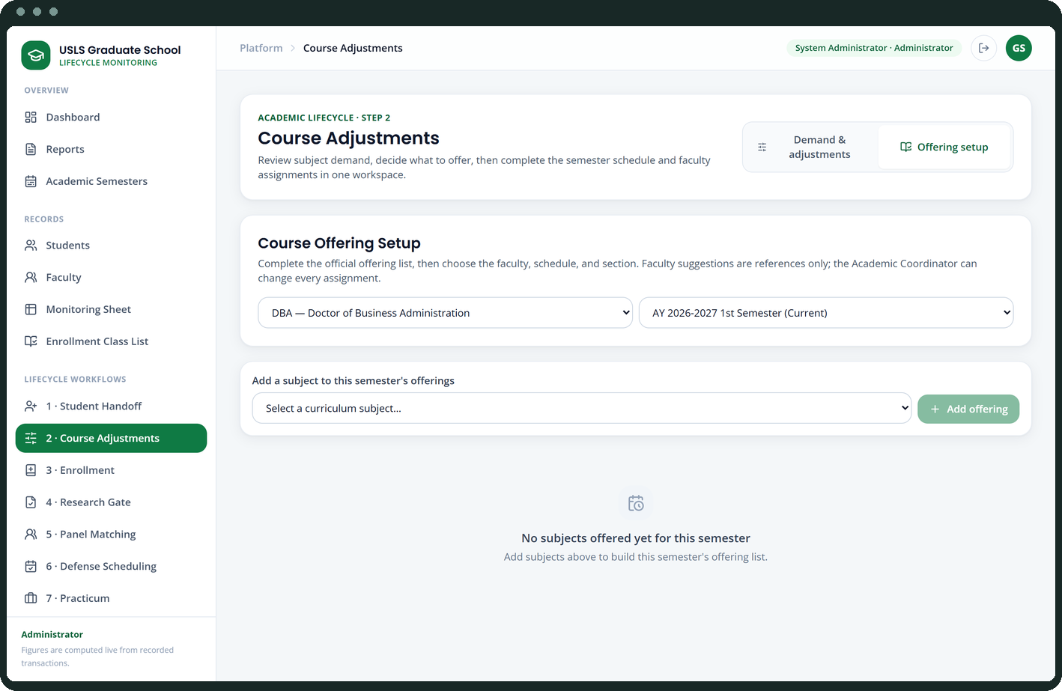
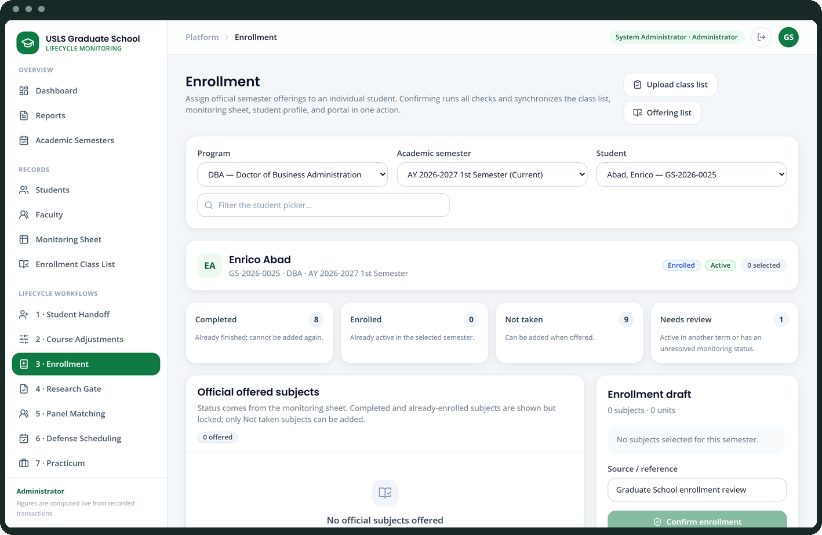
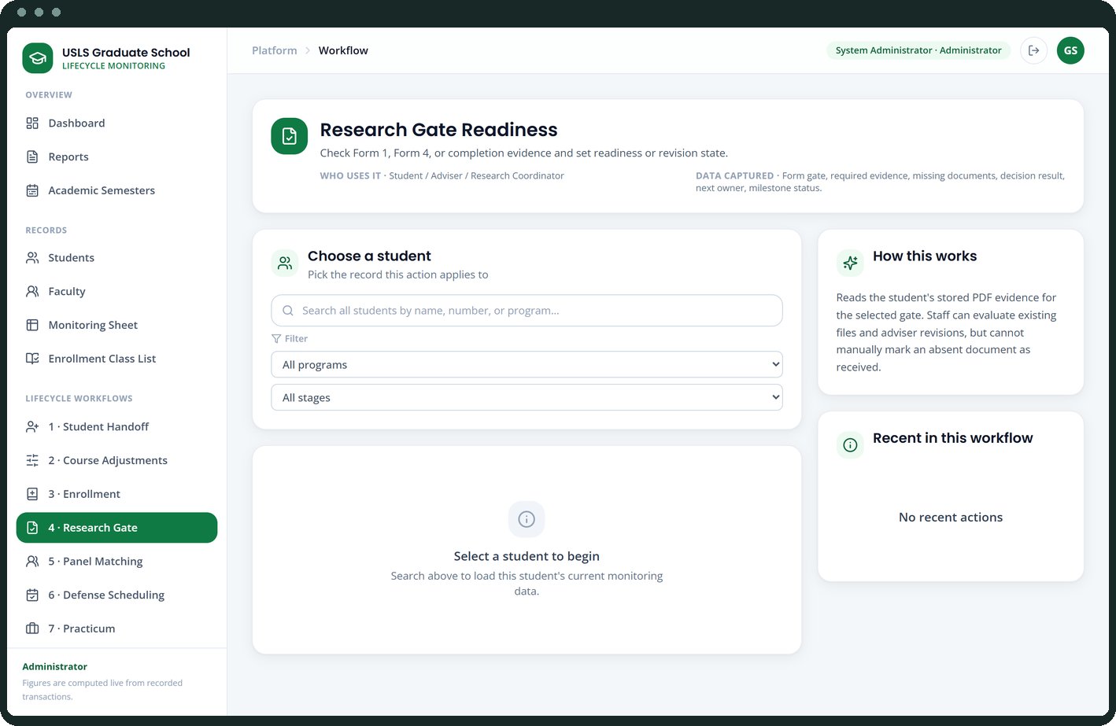
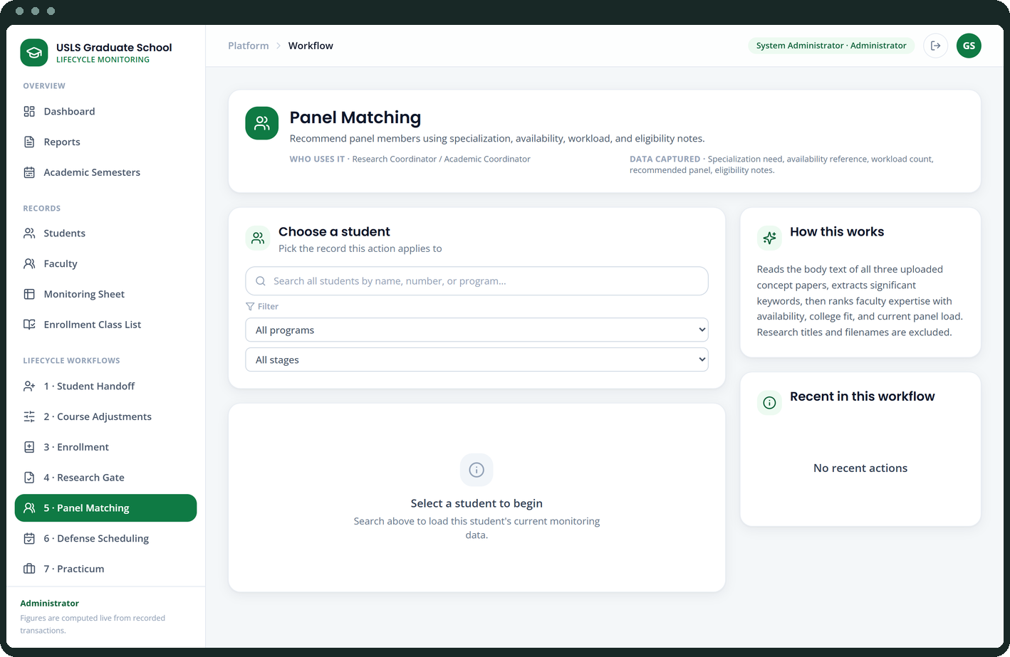
APPENDIX
System screens
13–18 of 36
Coursework report to Dean
Course offering setup
Enrollment
Curriculum version & study plan
Research gate
Panel matching

Slide 15
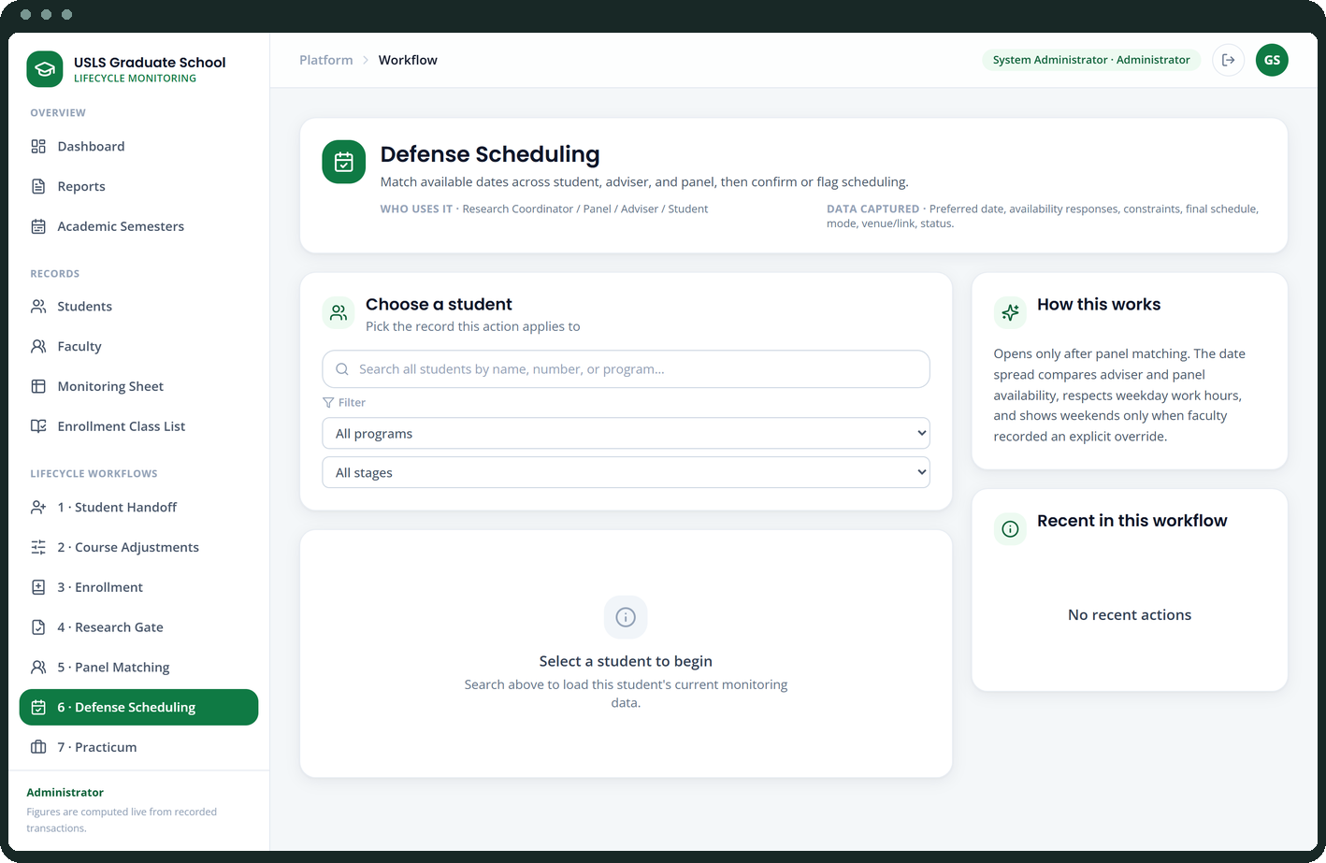
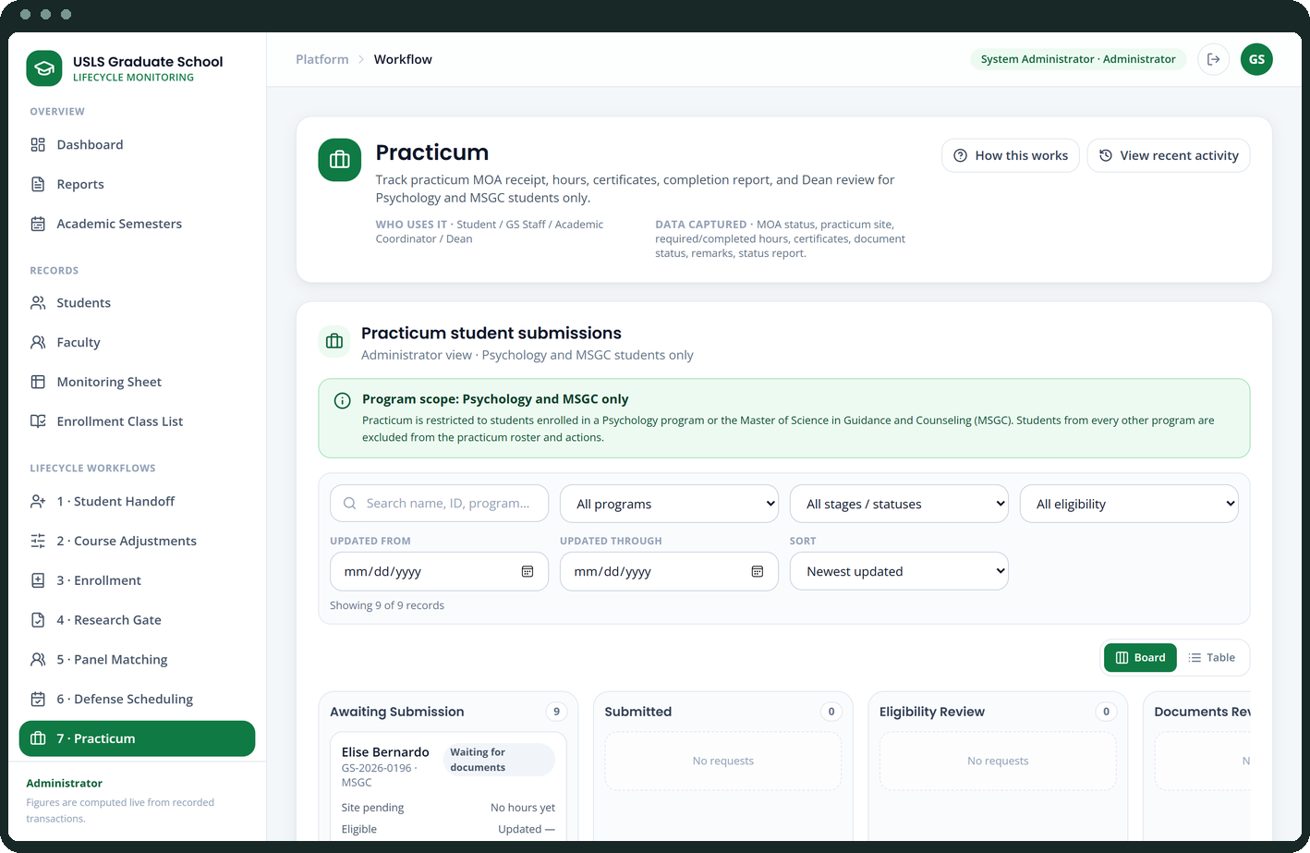
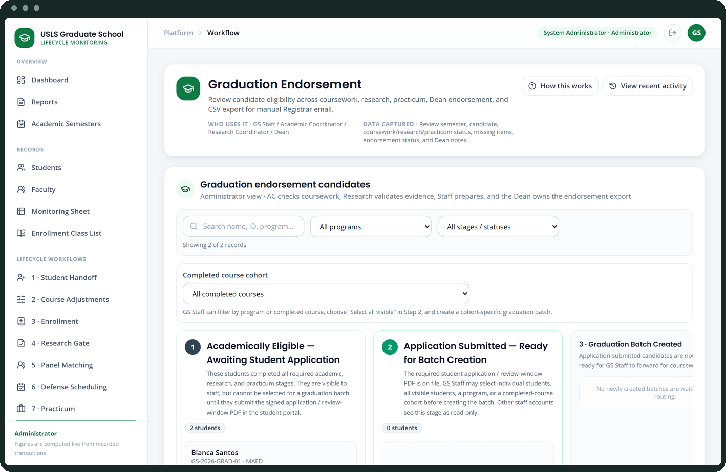
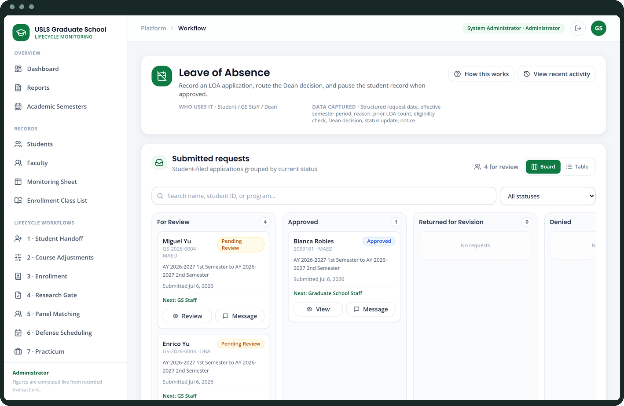
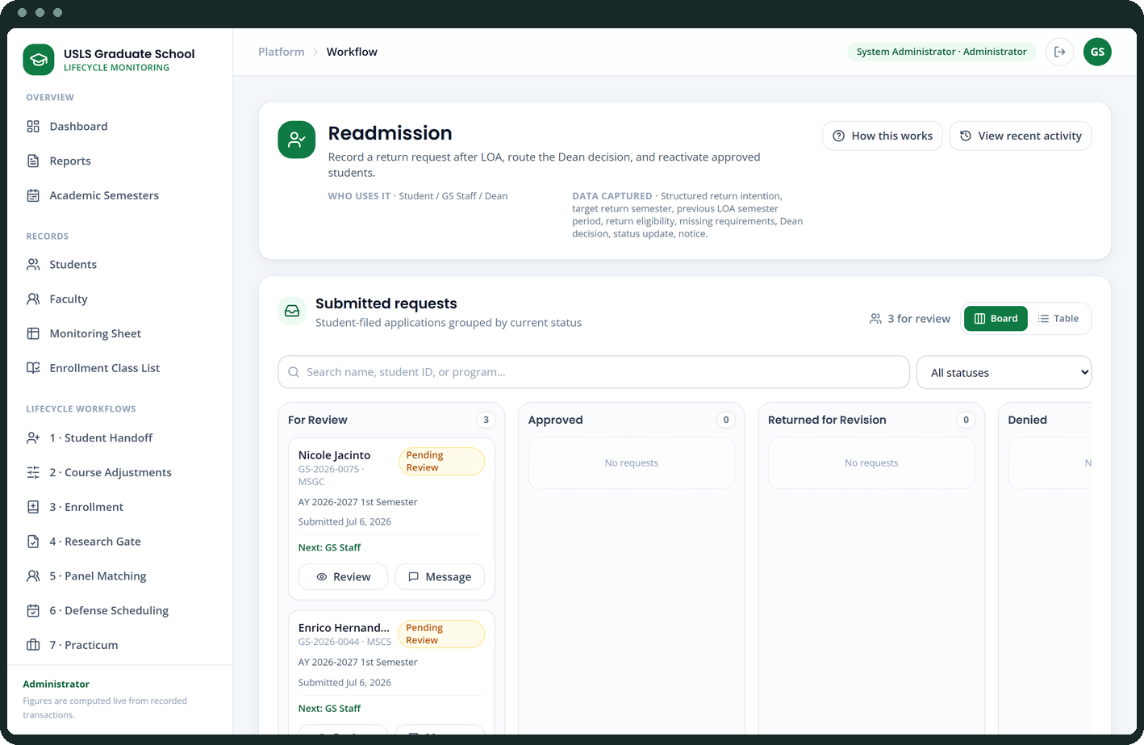
APPENDIX
System screens
19–24 of 36
Defense scheduling
Practicum
Graduation
Leave of absence
Readmission
AWOL & residency

Slide 16
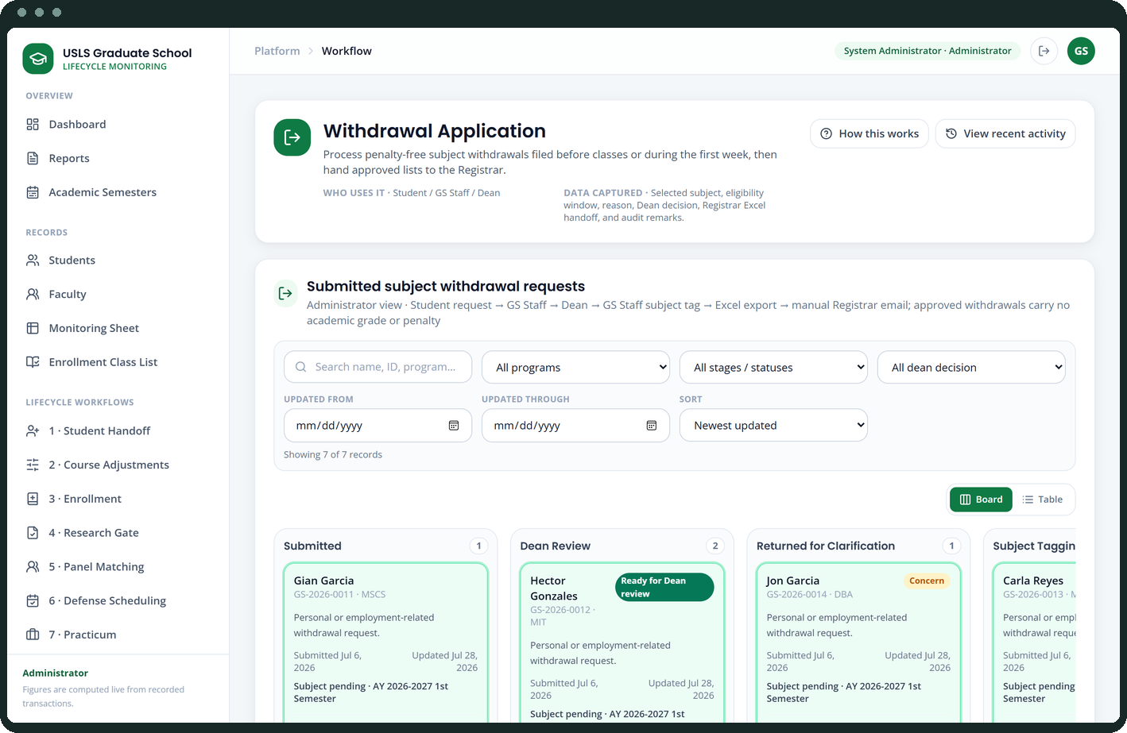
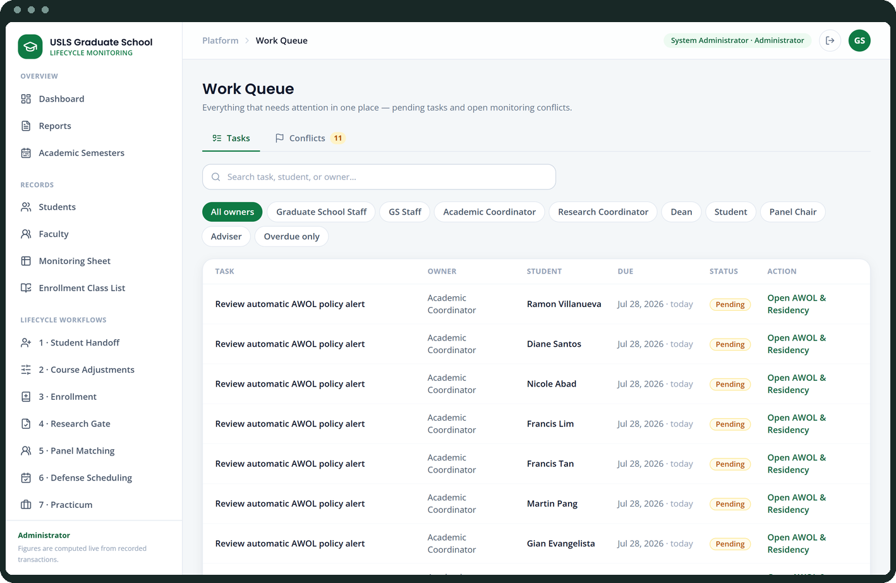
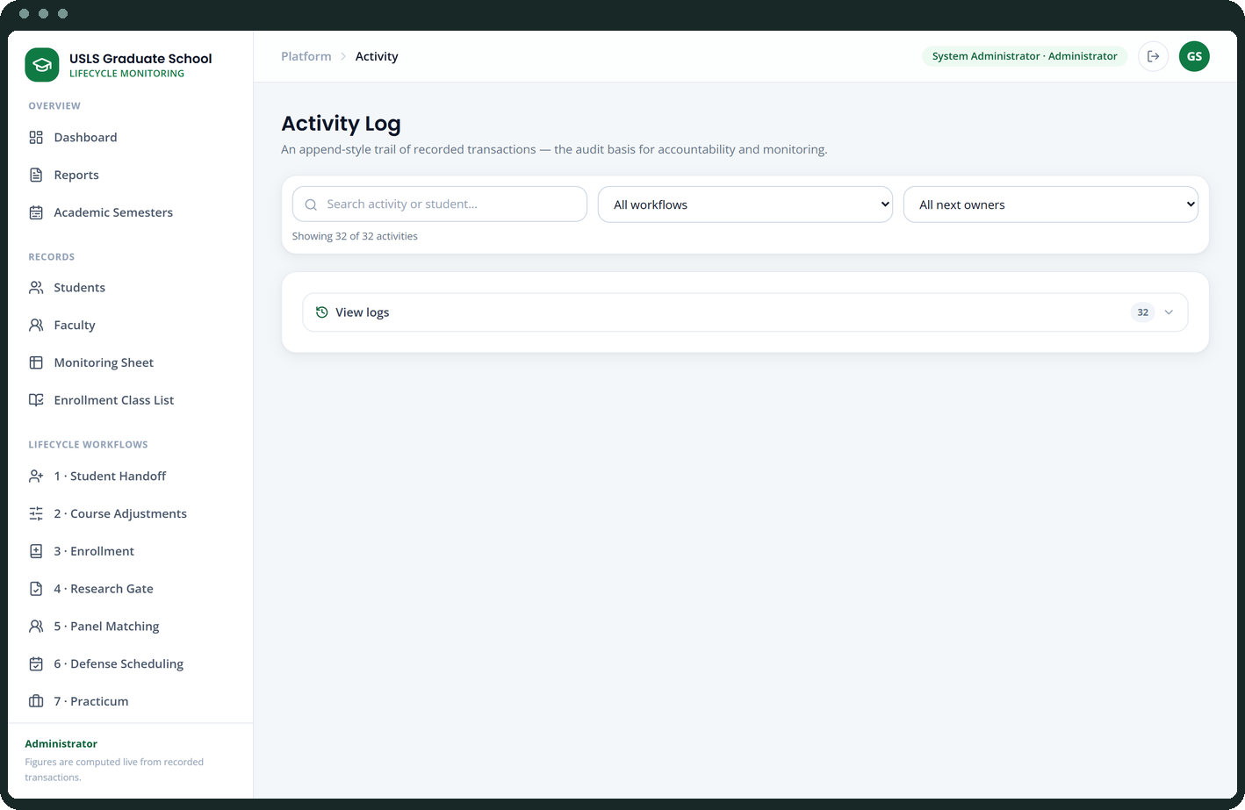
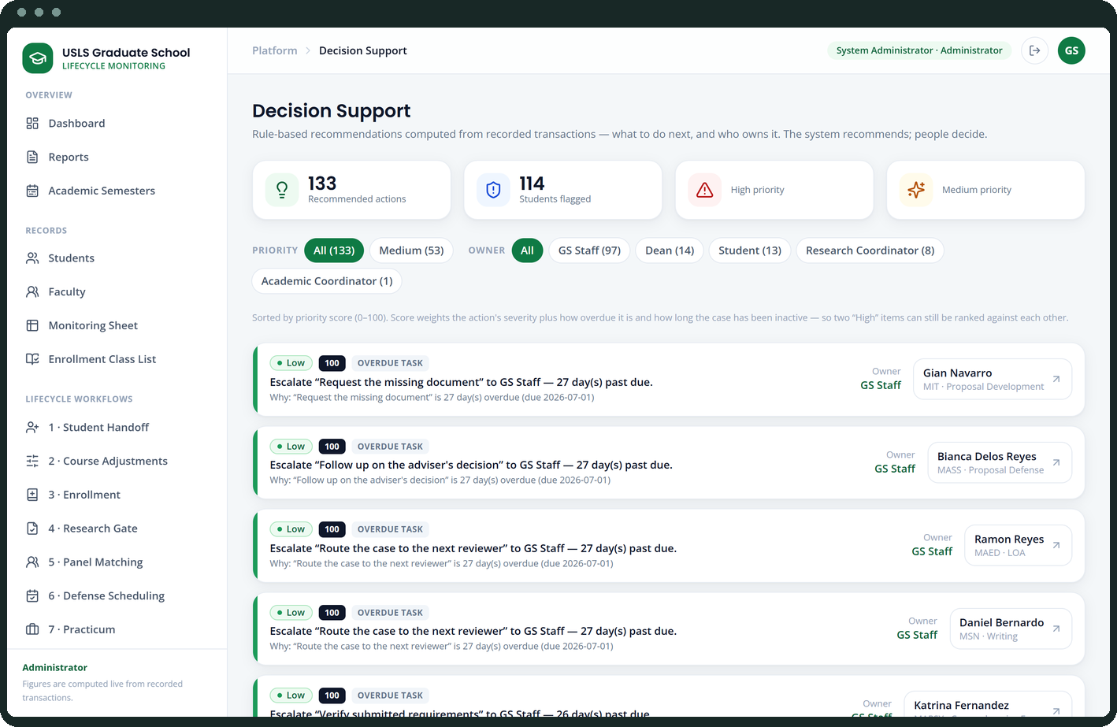
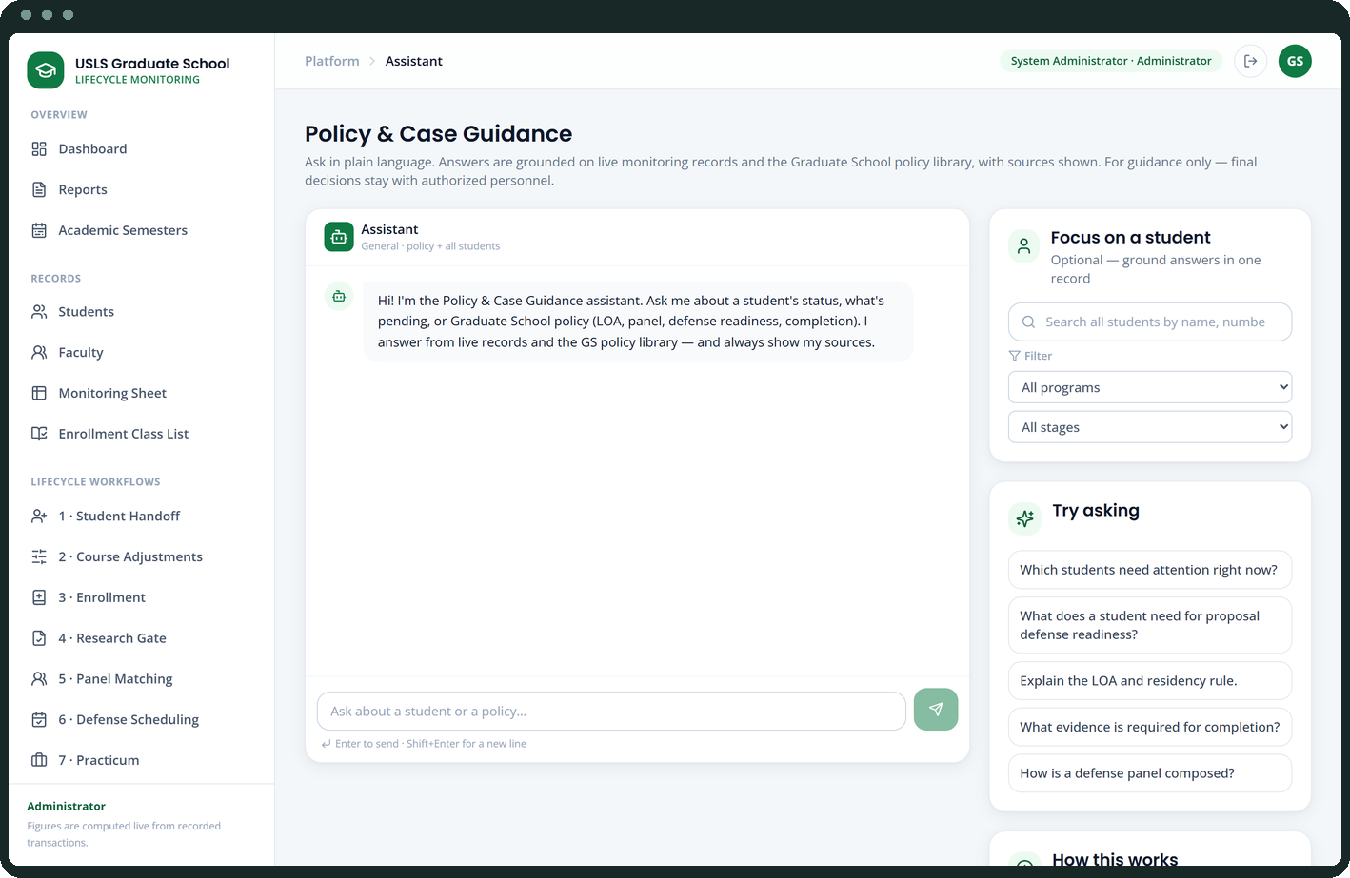
APPENDIX
System screens
25–30 of 36
Subject withdrawal
Work queue
Activity log
Recommendations
Policy assistant
Form 1 endorsements

Slide 17
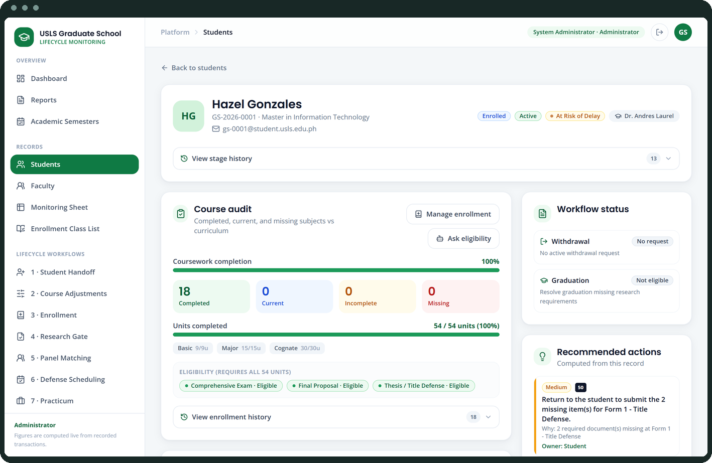
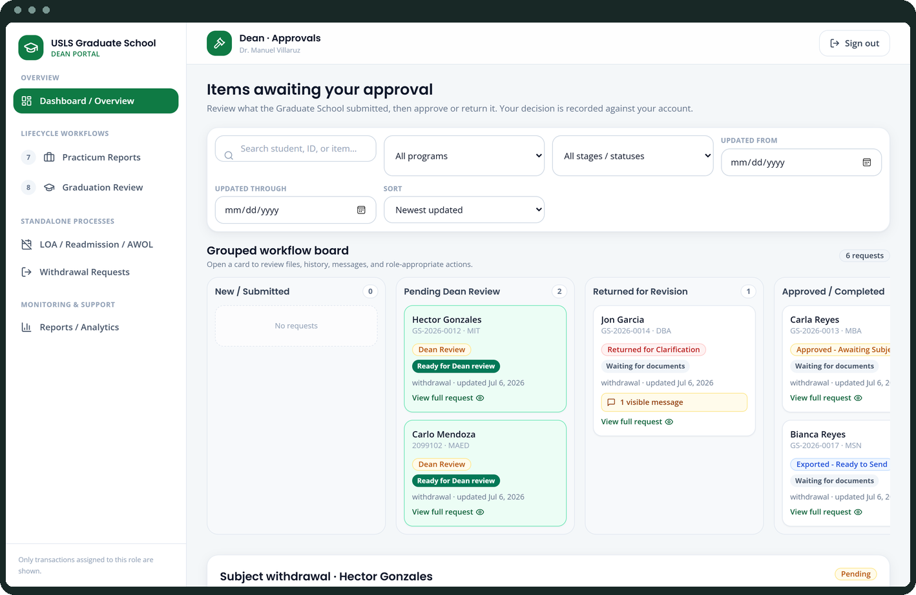
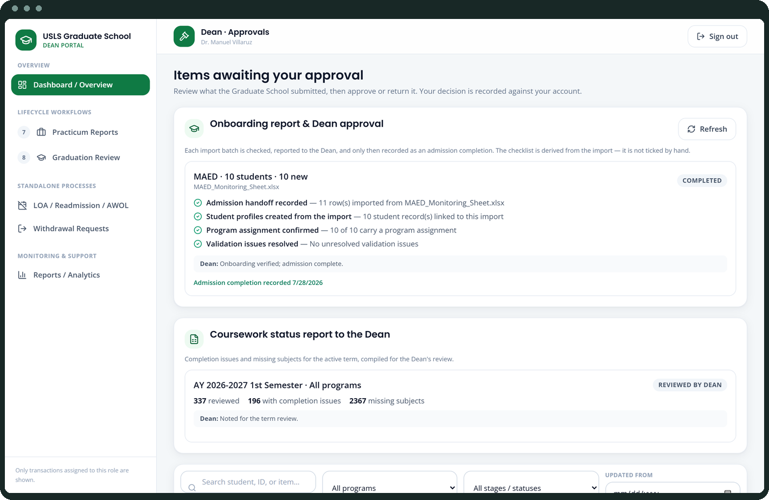
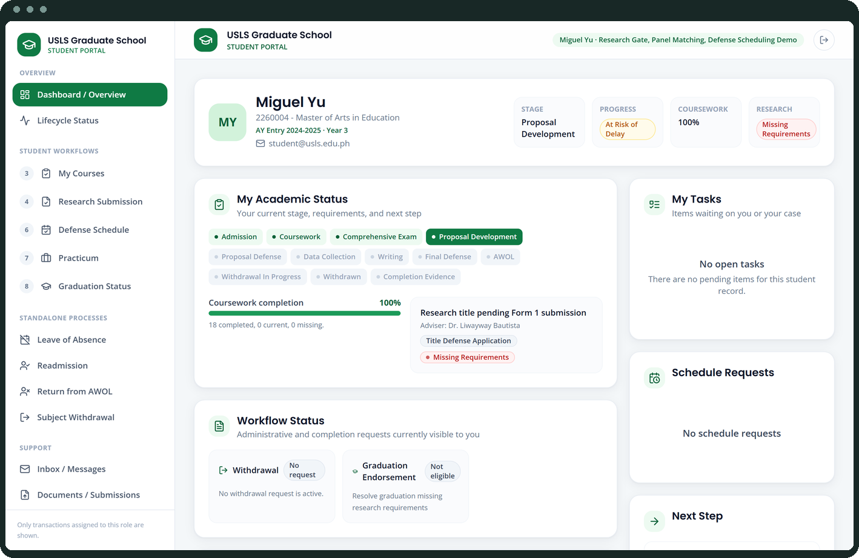
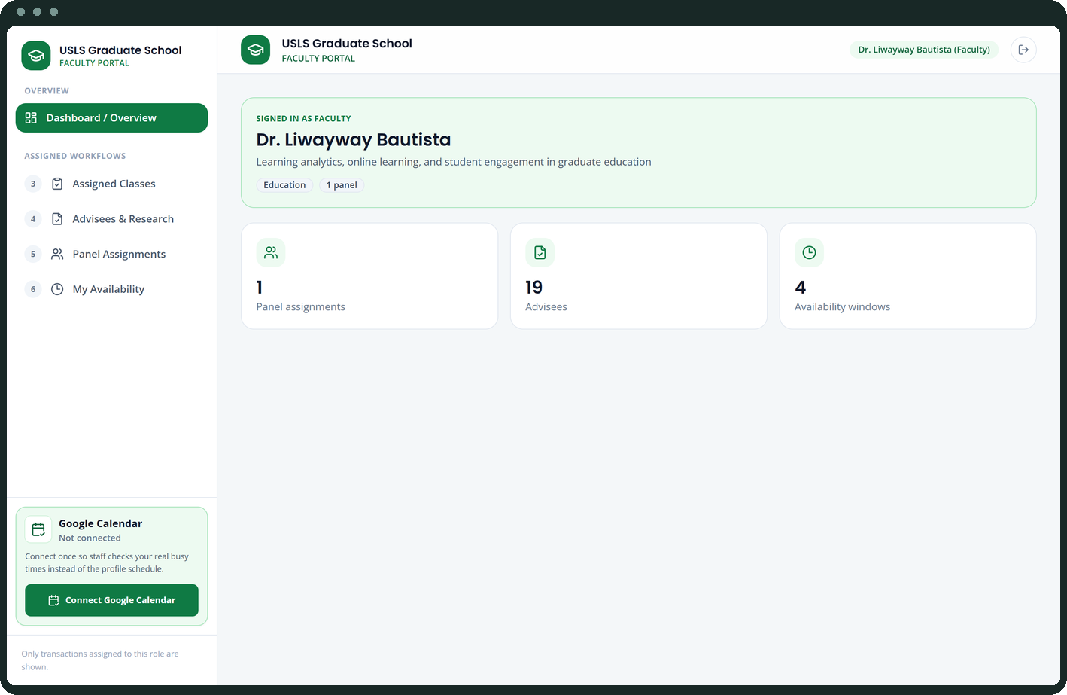
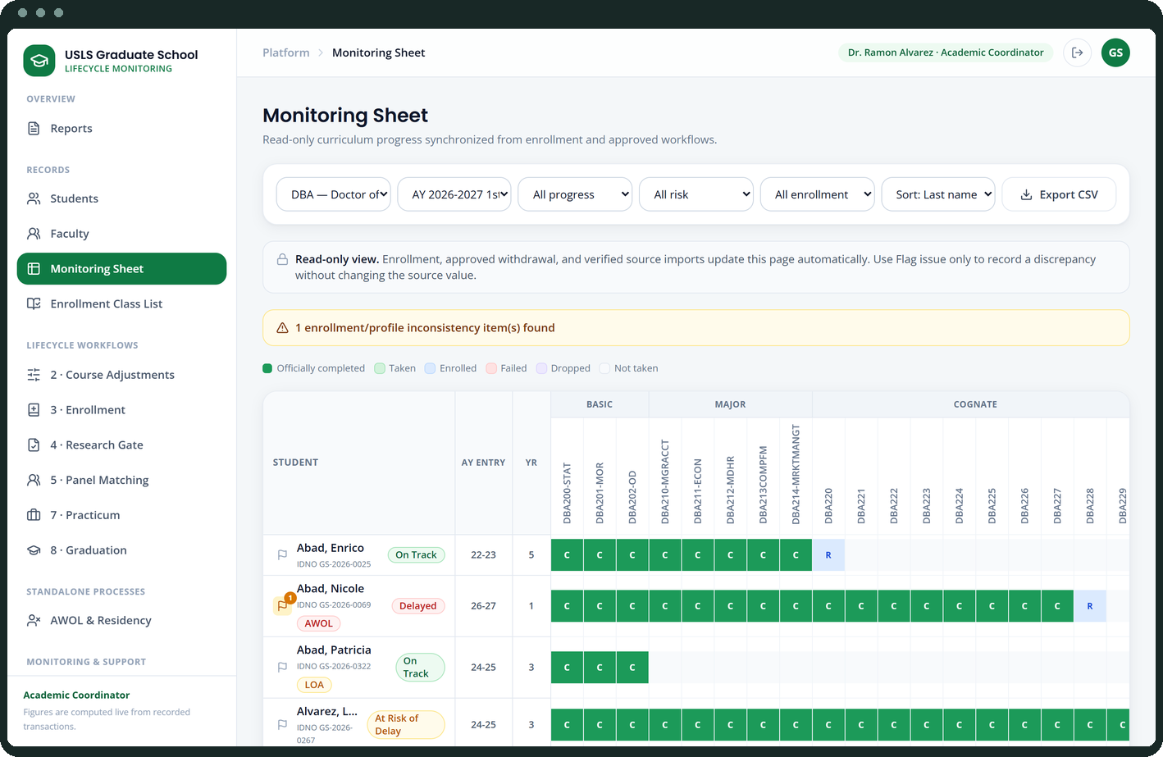
APPENDIX
System screens
31–36 of 36
Student detail
Dean approvals
Dean portal · report gates
Student portal
Faculty portal
Coordinator view

